Slide 1
[Project Title]
[Project Team Members]

Slide 2
Project Overview
[Short description of the project explaining the problem, current state, stakeholders, scope, and deliverables– may include pictures]
2

Slide 3
Methodology
[Overview of the methodology and approach learned during your program that will be applied to solve the problem]

Slide 4
Preliminary Results
[Include current status of the project, preliminary results, and estimated benefits (if available at this time)]

Slide 5
Optimizing Workflow and Efficiency in General Assembly
EXAMPLE
Student Name

Slide 6
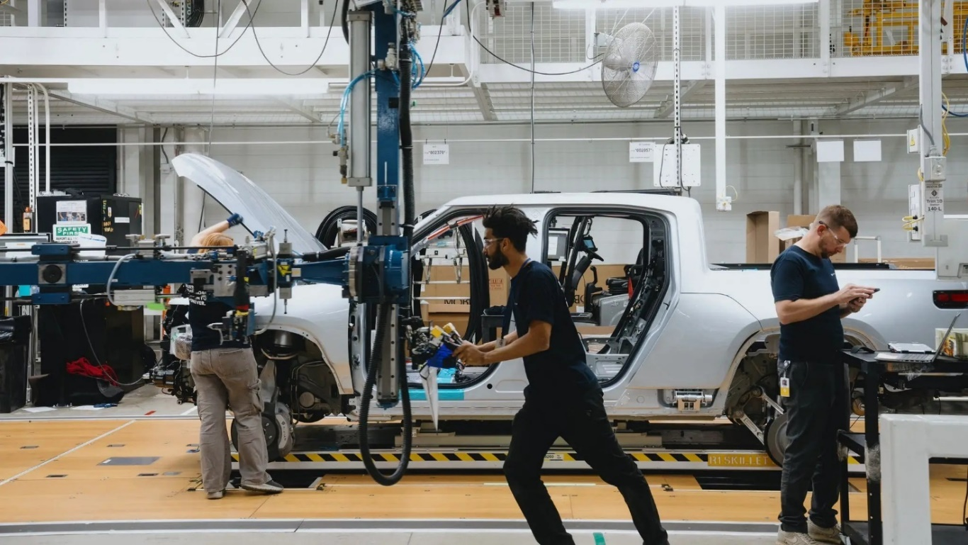
Project Overview - Example
Enhance efficiency of the General Assembly lines
  Maximize productivity
  Ensure seamless operations
  Improve throughput
  Improve customer satisfaction
Currently assembly line design is
creating uneven workload distribution
  Target rebalancing of workstations to reduce cycle times and align to takt time of 240 seconds
Internal stakeholders: management, line workers, process engineers, operations engineers
External stakeholders: customers and shareholders/investors
6

Slide 7
Project Scope and Deliverables - Example
Scope
  Rebalancing of all workstations within the General Assembly lines
Deliverables
  Balanced Line Layout Proposal
  Validated Trial Plan for Implementation
  Comprehensive Project Report

Slide 8
Methodology - Example
Define
Measure
Analyze
Improve
Control
Video Recording Time Studies
MODAPTS Time Studies
YAMAZUMI Rebalancing Charts
Pilot Trials for Improvement

Slide 9
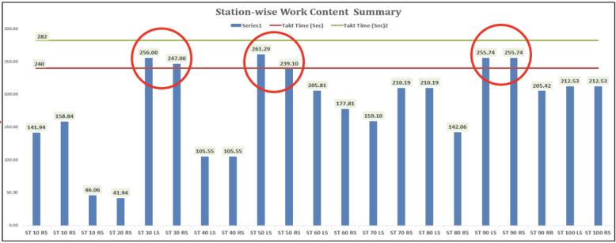
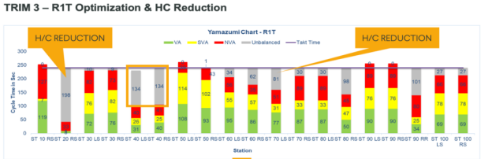
Preliminary Results - Example
Trim 3 General Assembly Rebalance
  Shift operations from 40LS to 30LS
  Reallocate operations at 70LS
  Shift operation from 90RF to 80RS
Trim 3 Headcount Reduction
  $200,000 cost savings

Slide 10
Project Benefits - Example
Increased Efficiency
  Reduced bottlenecks and delays
  30LS cycle time reduction of 23%
  40LS cycle time reduction of 19%
Headcount Reduction Cost Savings: $200,000
Other Benefits
  Improved throughput
    Ability to meet production demands by adjusting process time to takt
  Streamlined Material Flow
  Enhanced Customer Satisfaction
  Investor Confidence

